Slide 1
Big Data Analysis and Mining
Cluster Validity
Qinpei Zhao 赵钦佩
qinpeizhao@tongji.edu.cn

Slide 2
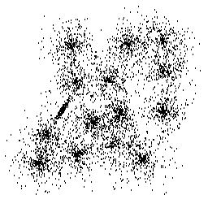
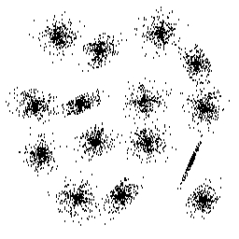
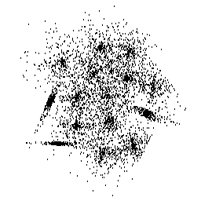
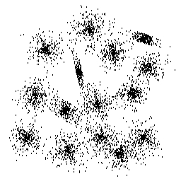
Background & Status
What do we have?

Slide 3
Data Sets:
s1
s2
s3
s4

Slide 4
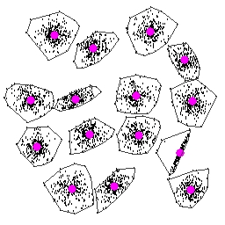
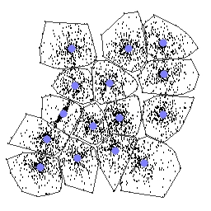
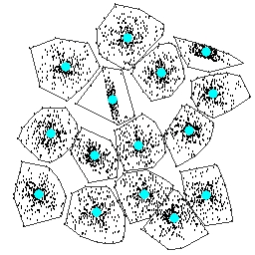
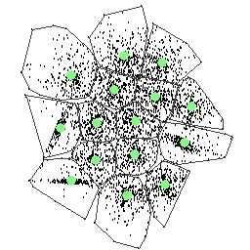
Background & Status
What do we have?
What have we done?

Slide 5
Clustering Results
s1
s2
s3
s4

Slide 6

Background & Status
Data Sets
Clustering Algorithms
What are we still struggling?
-- How many clusters?
-- How good clustering?

Slide 7
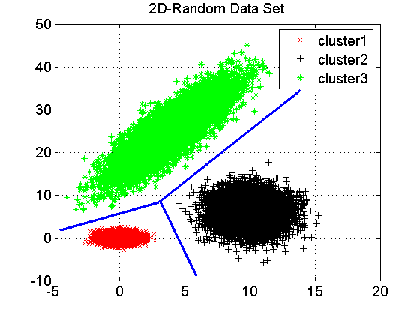
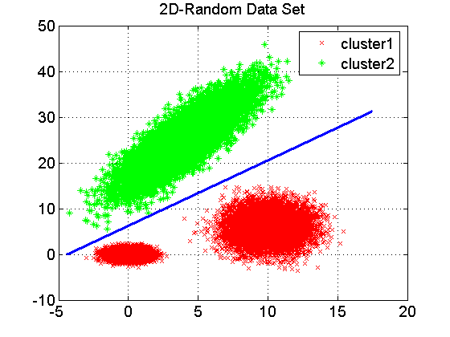
Problems
How many clusters?
How good clustering?

Slide 8
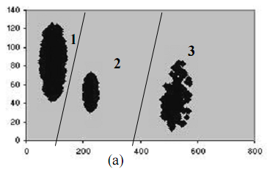
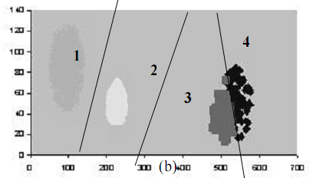
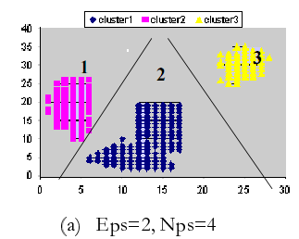
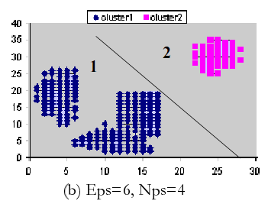
“Clusters are in the eye of the beholder”!
Figure1. (a) a data set consists 3 clusters. (b) the results by k-means when asking 4 clusters.
Figure2. different partition results from DBSCAN with different input parameter values.

Slide 9
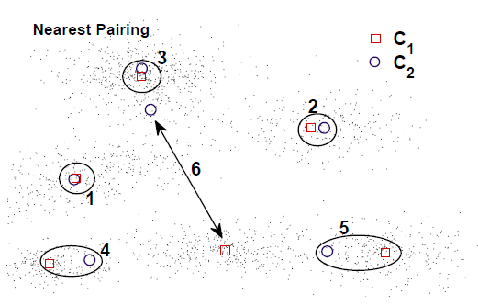
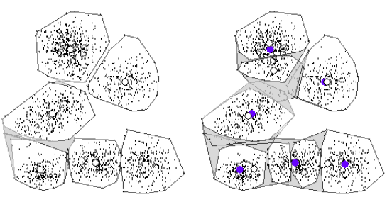
Why?
Evaluate the clustering results, especially in high dimensional data space
To compare clustering algorithms
To compare two sets of clusters
To compare two clusters

Slide 10
Different Aspects
Determining the clustering tendency of a set of data, i.e.,distinguishing whether non-random structure actually exists in the data.
Comparing the results of a cluster analysis to externally known results, e.g., to externally given class labels.
Evaluating how well the results of a cluster analysis fit the data without reference to external information.
- Use only the data
Comparing the results of two different sets of cluster analysis to determine which is better.
Determining the ‘correct’ number of clusters.

Slide 11
Measures of Cluster Validity
A Typical View of Cluster Validation Measures:
External measures
Match a cluster structure to a prior information, e.g., class labels.
E.g., Rand index, Γ statistics, F-measure, Mutual Information
Internal measures
Assess the fit between the structure and the data themselves only.
E.g., Silhouette index, CPCC, Γ statistics
Relative measures
Decide which of two structures is better, often used for selecting the right clustering parameters, e.g., the cluster number.
E.g., Dunn’s indices, Davies-Bouldin index, partition coefficient, Xie-Beni index
Other Views:
Partitional Indices vs. Hierarchical Indices
Fuzzy Indices vs. Non-Fuzzy Indices
Statistics-based Indices vs. Information-based Indices

Slide 12
Survey
Status
30 indices comparison (hierarchical clustering algorithms) by Milligan and Cooper 1985
15 indices comparison (binary data sets) by Dimitriadou et al. 2002
Comparison on Internal indexes by Q. Zhao 2014
Existing techniques
Davies-Bouldin index
Dunn’s index
Calinski-Harabasz index
Bayesian Information Criterion (BIC)
Rand Index
Jaccard……

Slide 13
Sum-of-square based index
SSW:
SSB:
Define SSW/SSB as WB-ratio
Proposed index as:
wb-index = m•SSW/SSB

Slide 14
Sum-of-square based index
WB type index: which takes use of sum-of square Within and Between variance into the index (SSW & SSB)
History on WB type index:
SSW / m ---- Ball and Hall (1965)
m²|W| ---- Marriot (1971)
---- Calinski & Harabasz (1974)
log(SSB/SSW) ---- Hartigan (1975)
---- Xu (1997)
( d is the dimension of data; n is the size of data; m is the number of clusters)

Slide 15
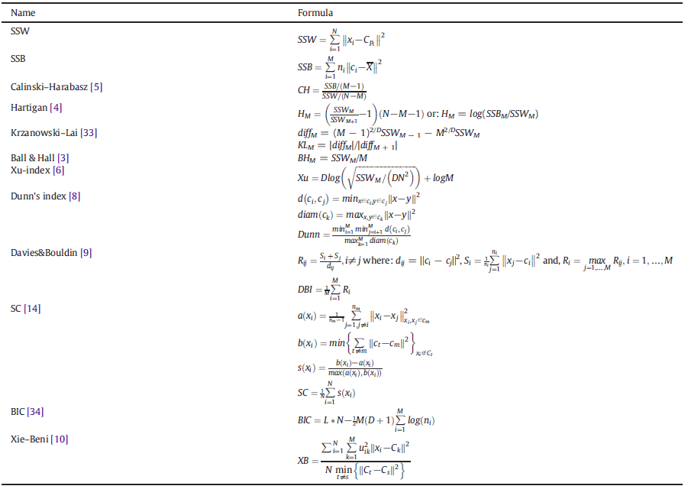
Internal Index

Slide 16
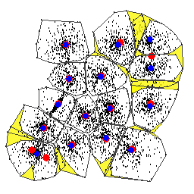
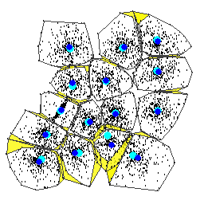
External Validity
External indices hard→soft
Resampling method
Determining the number of clusters
efficiently
RLS VS. KM (S3)
RLS VS. Genetic (S3)
P₁ - Partitions
P₂ - Partitions

Slide 17
External Index (1)
C={C₁,…,C_{k’}} (clustering structure) and
P ={P₁,…, P_{k}} (known partition)
a pair of points (X_{u}, X_{v})
Rand Statistic: R = (SS+DD)/(SS+SD+DS+DD)
Jaccard coefficient: J = SS/(SS+SD+DS)
Folkes and Mallows index: FM =
No. of pairs | Same cluster in C | Different clusters in C
Same class in P | SS | SD
Different class in P | DS | DD

Slide 18

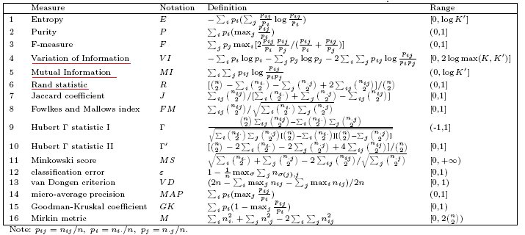
External Index (2)
Contingency Matrix
Confusion matrix

Slide 19
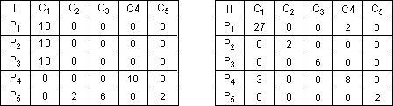
A test
Data: 50 documents from 5 classes. The class sizes are 30, 2, 6, 10, and 2, respectively. i.e. |C|= {30, 2, 6, 10, 2}
Two clustering results are as follows. Which one is better?

Slide 20
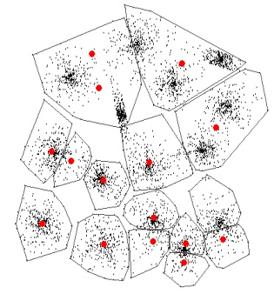
Determining the K
Typical procedures:
Input a dataset X;
Define range of the number of clusters K = [K_{min}, K_{max} ];
for each K: run clustering algorithm;
Calculate the value of certain validity index on the clustering result;
Plot the “number of clusters vs. index metric” and use features of the plot to determine the optimal K*.
Parameter K
Partitions P Codebook C
INPUT:
DataSet(X)
Clustering Algorithm
Validity Index
K*
Scheme diagram of cluster validity process

Slide 21

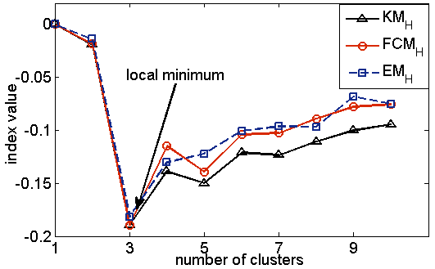
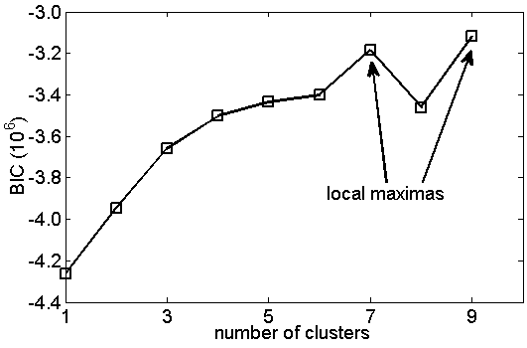
Cluster Validity in Image Segmentation

Slide 22
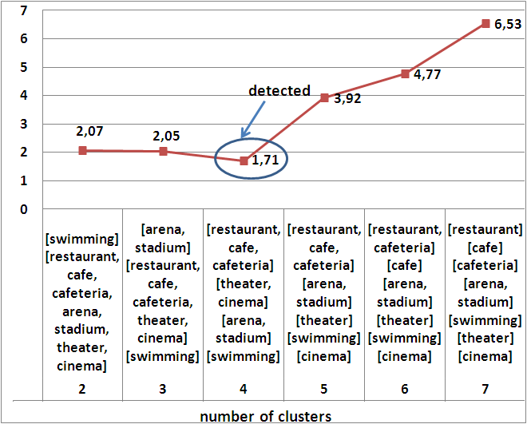
Text categorization

